Slide 1
Data Loss Prevention solution with the Microsoft Graph

Slide 2
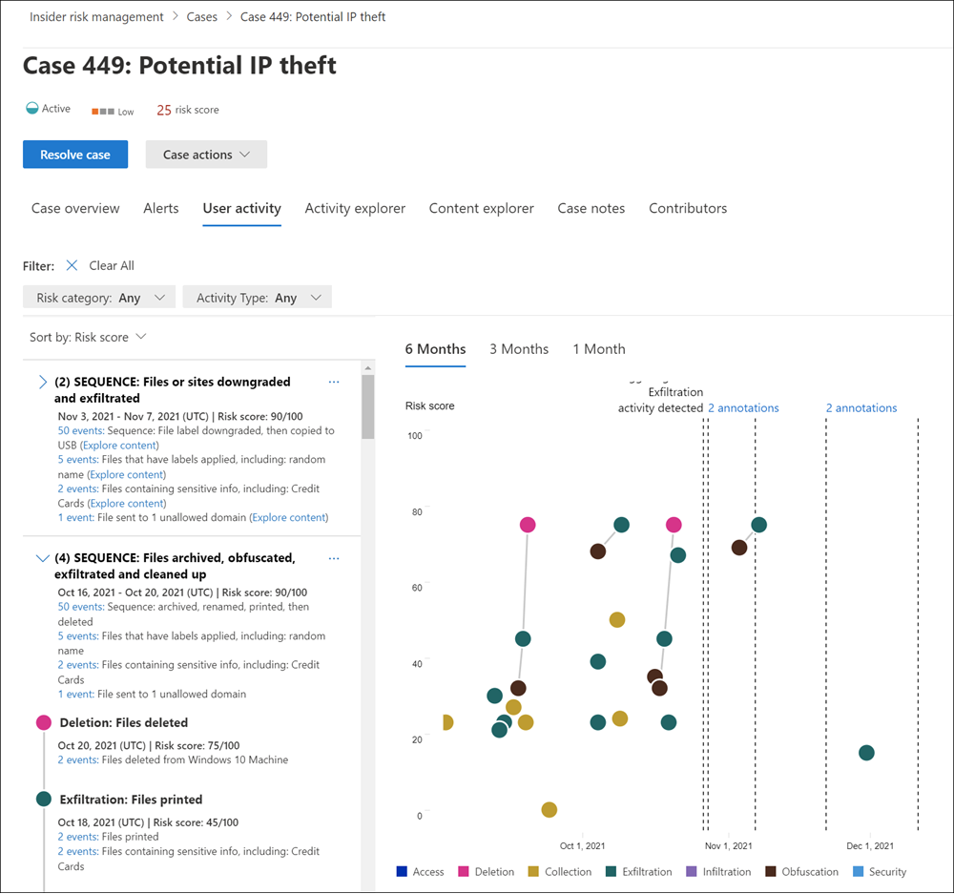
Insider Risk Management (Purview)
Very broad spectrum of policies and alerts
HR Connector needs a CSV file uploaded through PowerShell
Not customizable

Slide 3

How to create our own Email Monitoring Solution
Microsoft Graph subscriptions to the rescue

Slide 4

Demo

Slide 5
Recap
We can use Microsoft Graph subscriptions to get notifications about events (in this case emails) but also
OneDrive
Group conversations
Outlook events
Security alerts
SharePoint list items
Users
Teams:
Callrecord
Chats
Channel updates
Presence
Teams
…

Slide 6
Recap
To increase performance and stability we can use Event Hubs
Public URL is not exposed with this using Event Hubs
Use transport rules to keep subscriptions to a minimum

Slide 7
Resources
https://docs.microsoft.com/en-us/graph/change-notifications-delivery
https://docs.microsoft.com/en-us/azure/event-hubs/event-hubs-dotnet-standard-getstarted-send

